Slide 1

Hospital Management System

Slide 2
Group-3
Saurabh Nare 2483299
Sonal Ambhore 2481930
Pankaj Palve 2480079
Nisarga G K 2479538
Parisa Venkata Siva Sai Gopi 2481958
Shital Dahiphale 2483754
Vemanna s 2482024
Pradip X 2480253
Prajakta Kale 2480257
Kunapareddy Meghana 2481805

Slide 3
Contents
Introduction
Why hospital management system ???
Objectives
Tools & languages used
System Requirements
App Flow
Features Available
Future Scope & Improvement
Conclusion

Slide 4
Hospital management system
Introduction:-
Hospital Management System provides benefits of enhanced Administration & Control ,Superior patient care ,strict cost control and improved profitability.
“Hospital Management System” is powerful, flexible and easy to use and is designed and developed to deliver real conceivable benefits to hospitals and Patient
User can search availability of a doctor and the details of a patient using the login. The Hospital Management System can be entered using a username and password.

Slide 5
Why hospital management system ?
HMS was introduced to solve the complications coming from managing all the paper works of every patient associated with the various departments of hospitalization with confidentiality. HMS provides the ability to manage all the paperwork in one place, reducing the work of staff in arranging and analyzing the paperwork of the patients.
HMS does many works like:
Maintain the medical records of the patient
Maintain the contact details of the patient
Keep track of the appointment dates
Tracking the bill payments.

Slide 6
Objective
Main objectives of a Hospital Management System are:
Design a system for better patient care.
Reduce hospital operating costs.
Provide Management Information System report on demand to management for better decision making.
Better co-ordination among the different departments.
Provide top management a single point of control.

Slide 7
System Requirements
The Basic System Requirements for Running this project are listed below:
Angular, STS and Sql workbench to be installed to the system
572 MB Random Access Memory
200 MB of Free Space on Hard Disk
Microsoft Windows XP or Linux or Equivalent OS
Web Browser Internet Explorer Version 10

Slide 8
Tools & Languages Used
Front End
Visual Studio
Angular
Html
CSS
Back End
Spring Tool Suite
Sql Workbench
Eclipse IDE
Spring Boot

Slide 9

Modules of hospital management system
Admin Module
Patient Module
Doctor Module
Appointment Module
Feedback Module

Slide 10
ADMIN MODULE:
In the Admin Module the Admin could login and signup .
The Admin can see the Doctor List, Patient List .
In the Doctor’s List the Admin can perform UPDATE and DELETE operation.
In the Patient’s List the Admin can perform DELETE operation.

Slide 11
DOCTOR MODULE
Doctor can Login and Signup
Doctor can see the Appointment List and Discharge List
Doctor can DELETE the Appointment

Slide 12
PATIENT MODULE
Patient can Login and Signup
Patient can see the Doctor List
Patient can Register the Appointment.

Slide 13
Features Available
Admin
Doctor
Patient
Login
Create Admin Account
Doctor List
Patient List
Signup
Login
Appointment list
Signup
Login
Doctor details
Appointment registration

Slide 14
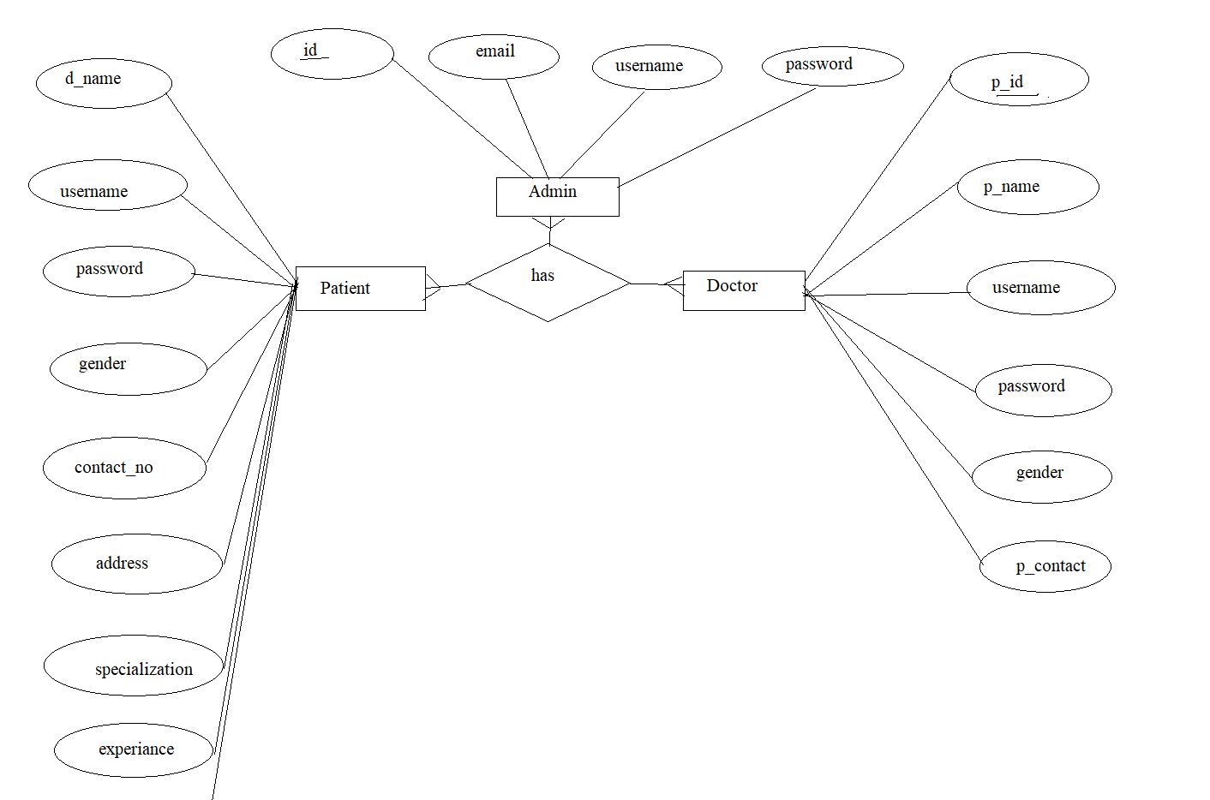
E R Diagram

Slide 15
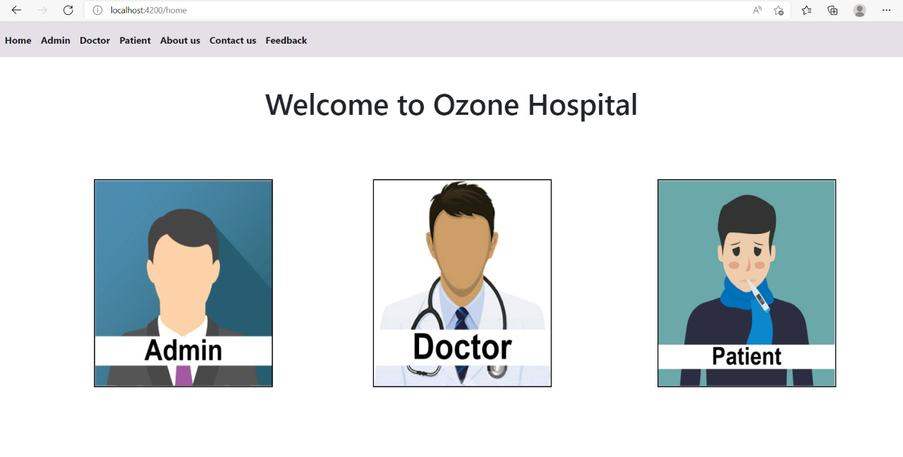
Workflow With Diagram:-Hompage

Slide 16
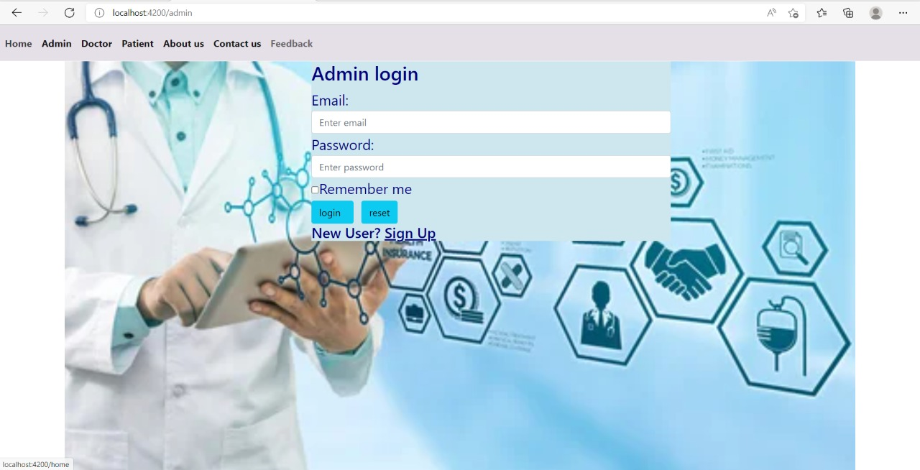
Admin Login Page

Slide 17
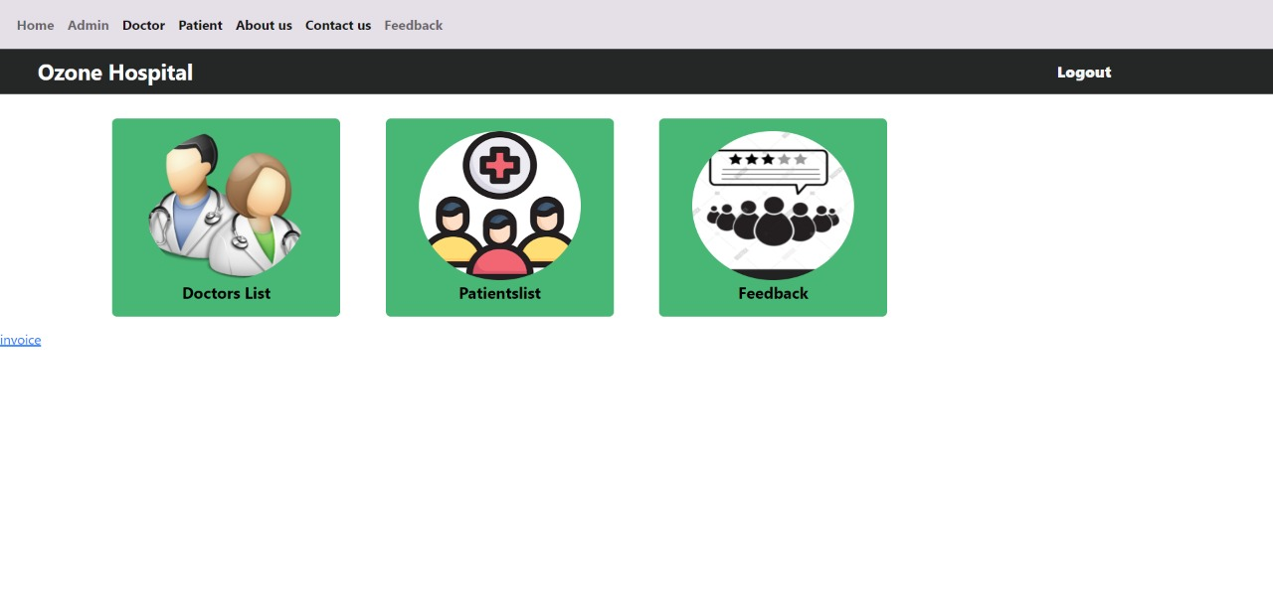
Admin Dashboard

Slide 18
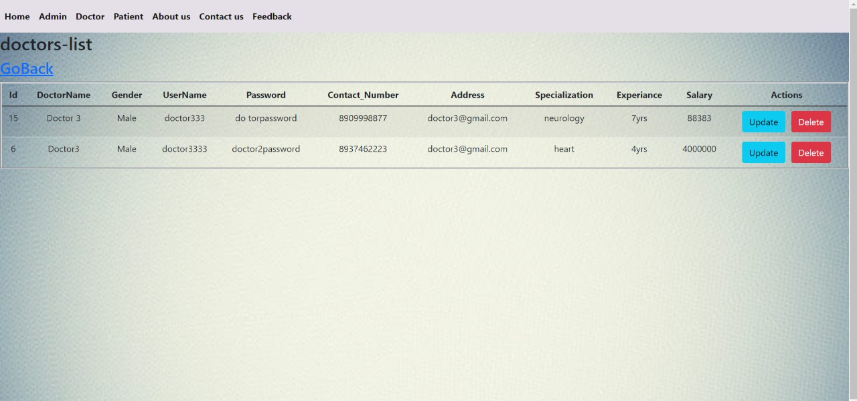
Admin View Doctor

Slide 19
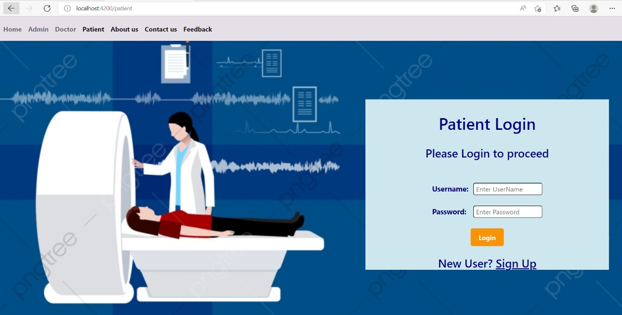
Patient

Slide 20
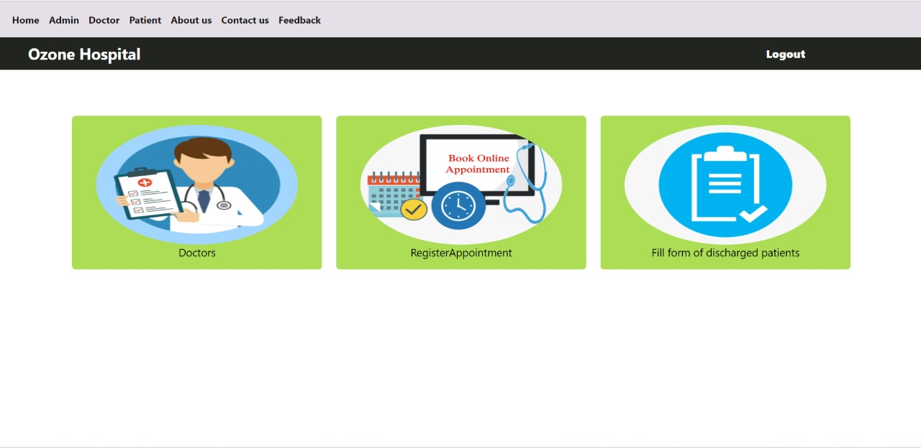
Patient Dashboard

Slide 21
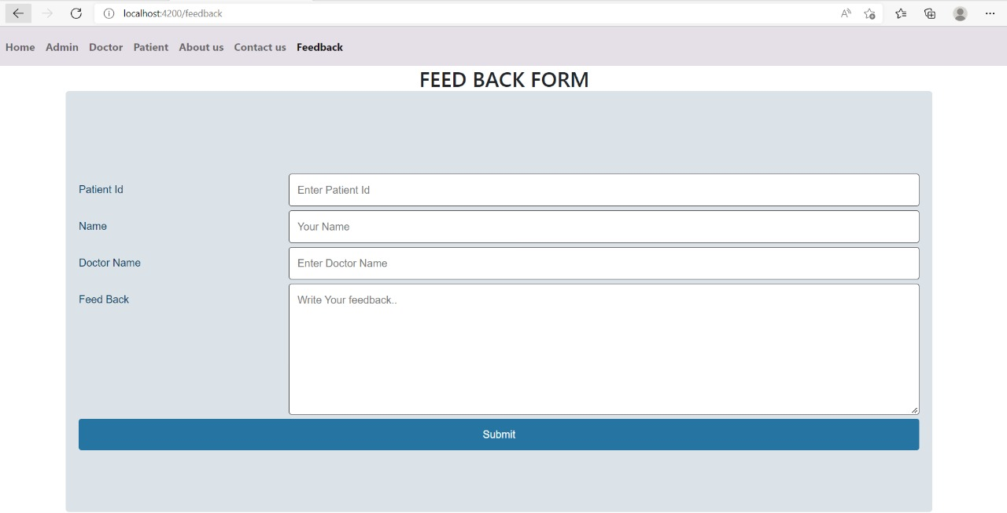
Feedback

Slide 22
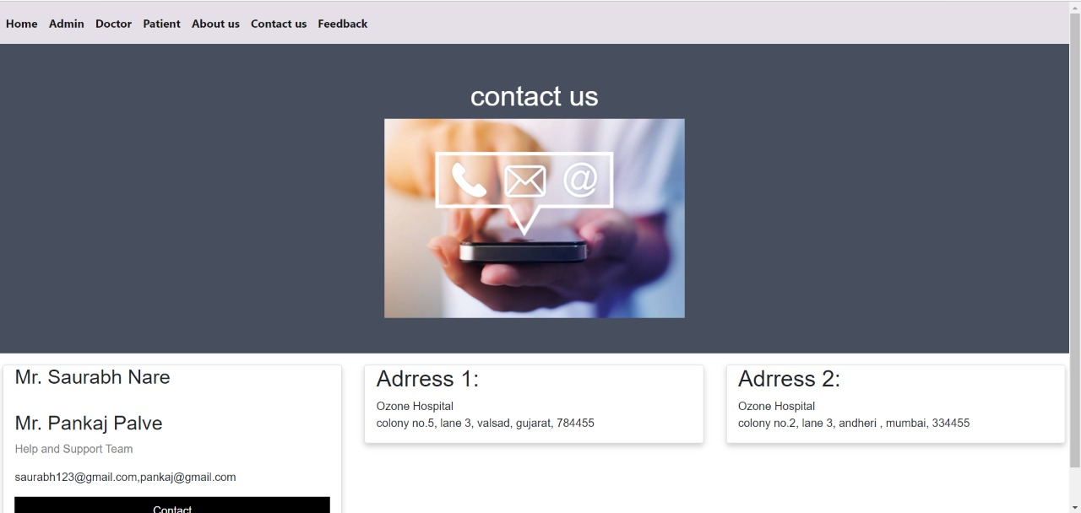
Contact us

Slide 23
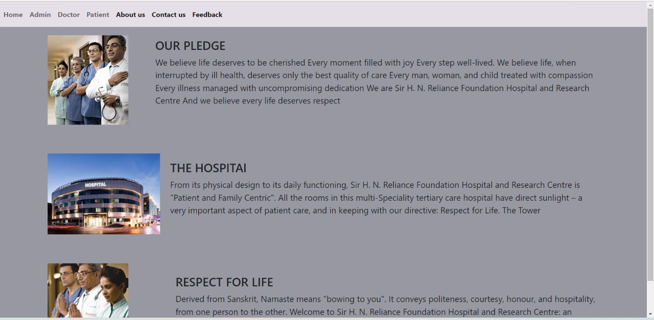
About Us

Slide 24
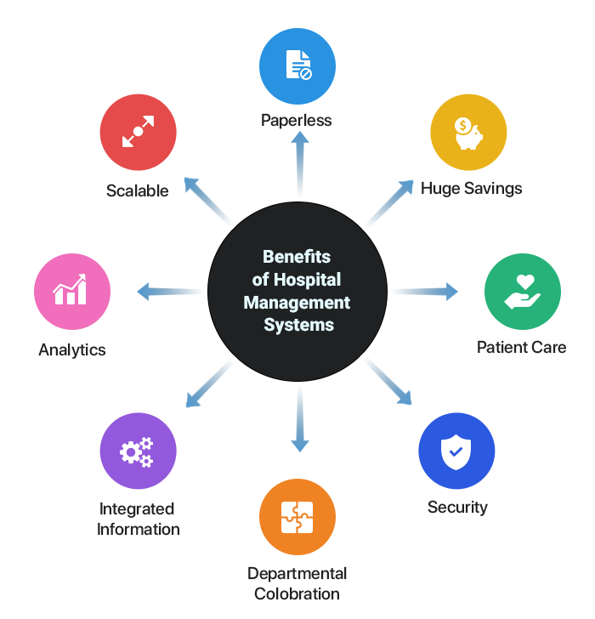
Benefits:
Appointment booking
Helps patients cut the long queue and saves their time
Role-Based Access Control
Allows employees to access only the necessary information to effectively perform their job duties
Increases data security and integrity

Slide 25
Benefits
Overall cost reduction
Cuts down paper costs as all the data are computerized
No separate costs for setting up physical servers
Data accuracy
Removes human errors
Alerts when there’s a shortage of stock
Data security
Helps to keep patients records private
Restricts access through role-based access control
Revenue management
Makes daily auditing simple
Helps with statistics and other financial aspects

Slide 26
Disadvantage
It is more expensive for the hospital.
Software implementation in the process is very tough

Slide 27
Future scope & Improvements
SMS notification after successful Book Appointment
Lab module shows the test results of the particular patient. The lab data can be viewed by the staff and generated for the patients’ reports. It is usually integrated with other hospital information system modules for the better overall functionality of the system.

Slide 28
Conclusion
we can make the conclusion that the hospital management system is the inevitable part of the lifecycle of the modern medical institution. It automates numerous daily operations and enables smooth interactions of the users.
Developing the hospital system software is a great opportunity to create the distinct, efficient and fast delivering healthcare model. Implementation of hospital management system project helps to store all the kinds of records, provide coordination and user communication, implement policies, improve day-to-day operations, arrange the supply chain, manage financial and human resources, and market hospital services.
This beneficial decision covers the needs of the patients, staff and hospital authorities and simplifies their interactions. It has become the usual approach to manage the hospital.

Slide 29
Bibliography
www.stackoverflow.com
www.w3school.com
www.angular.io
https://www.partech.nl/nl/publicaties/2020/07/9-trending-best-practices-for-rest-api-development

Slide 30


